Slide 1
CS 33 – Discussion 1A Computer System Organization
Week 5

Slide 2
Questions before we start?

Slide 3
Logistics
Lab 1 - Bomblab due tonight 11:59pm
Lab 2 – Attack lab will be released May 5th – Due Friday May 18th 11:55pm
HW 3 will be released soon, due May 10th
Please submit suggestions on CCLE TA-site on how to improve OH or DISC
Please fill out LA survey on CCLE

Slide 4
Agenda
10am-11am PST:
Go through midterm together?
Floating point
Stack overflow attacks
Optimization
11am-11:50am PST:
LA worksheet

Slide 5
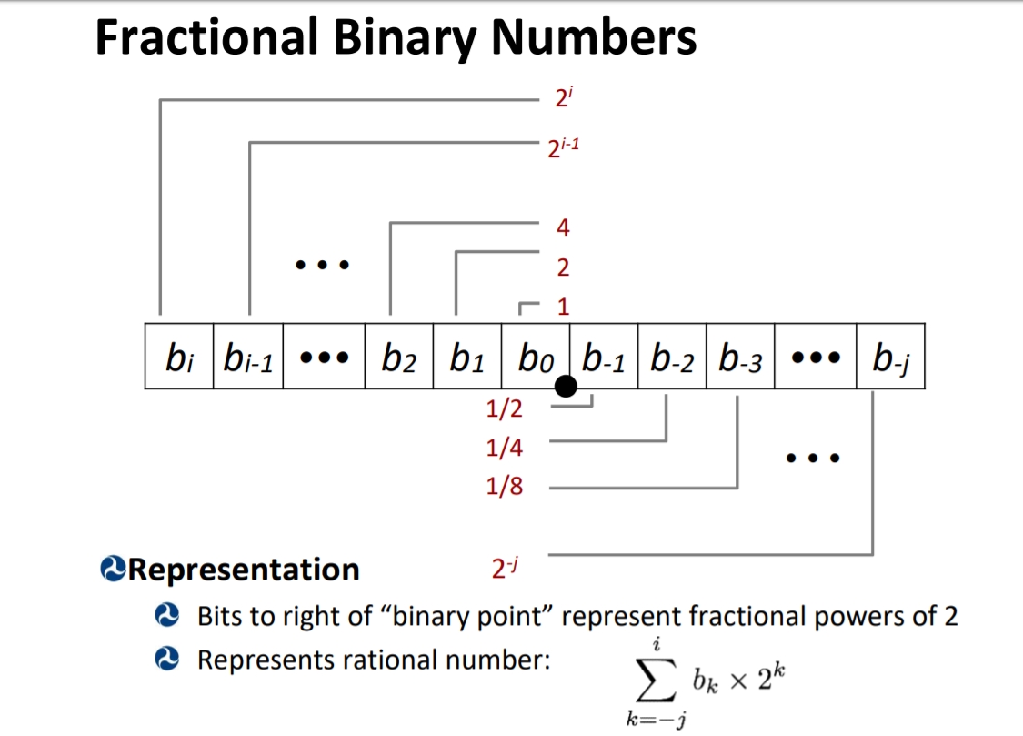
x86-64 Basics – Floating point

Slide 6
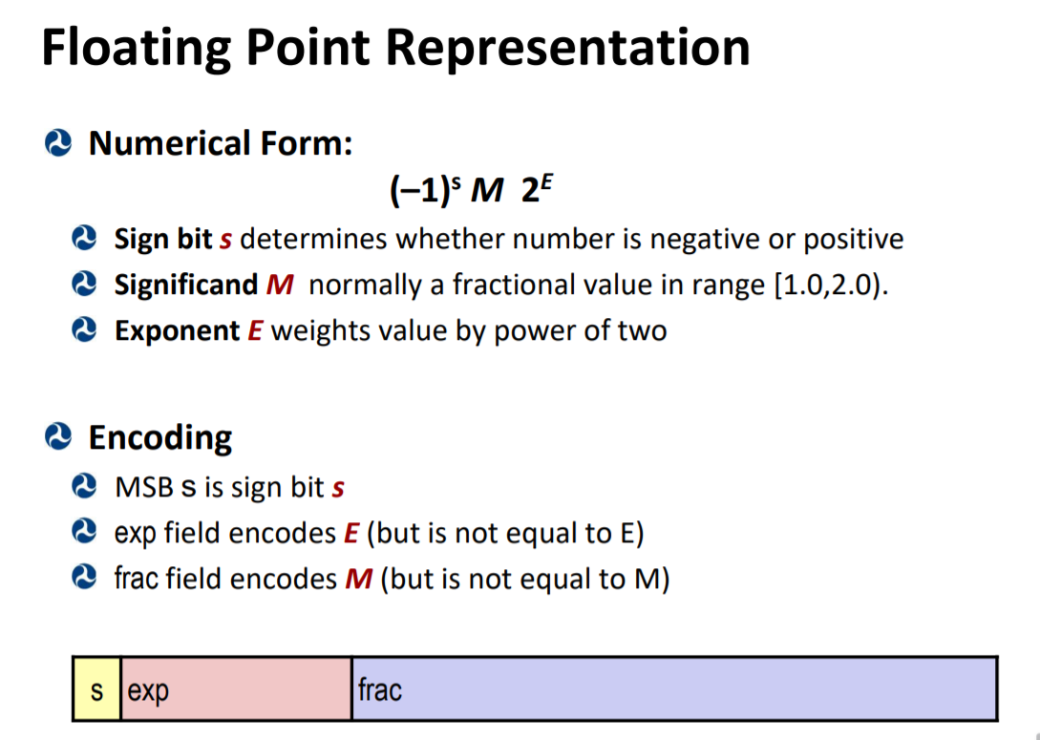
x86-64 Basics – Floating point

Slide 7
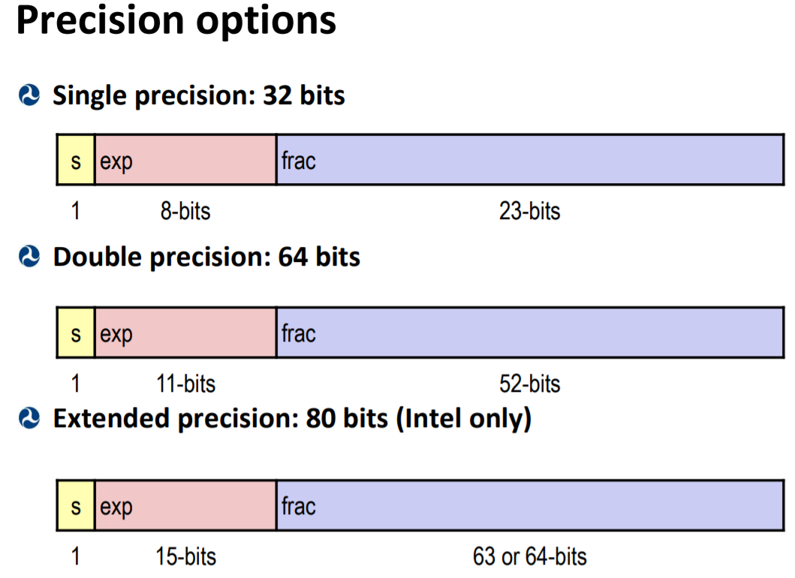
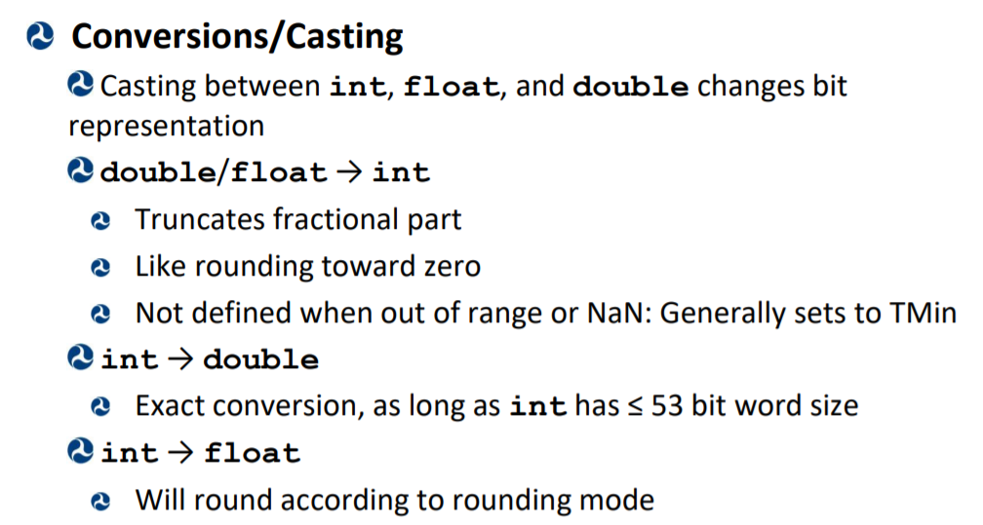
x86-64 Basics – Floating point

Slide 8
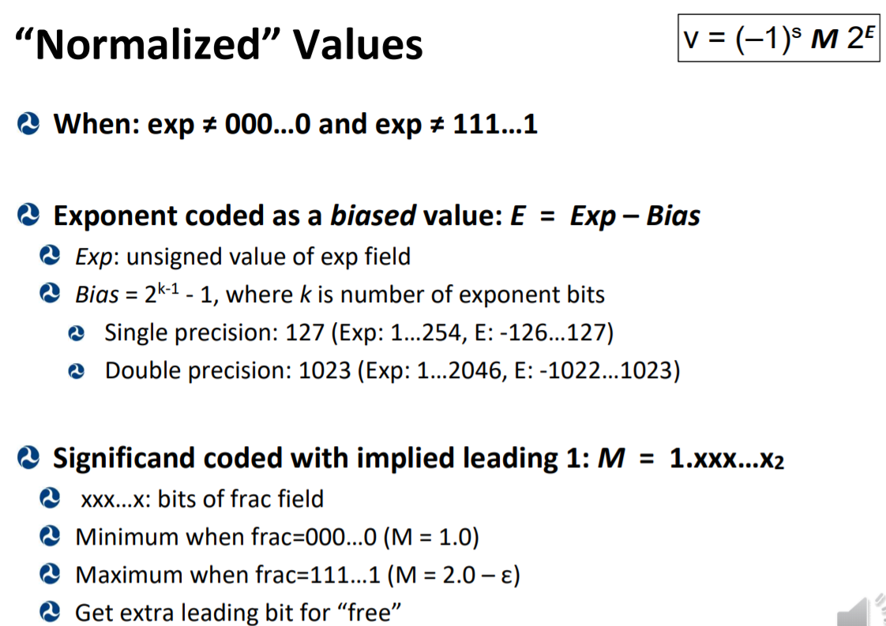
x86-64 Basics – Floating point

Slide 9
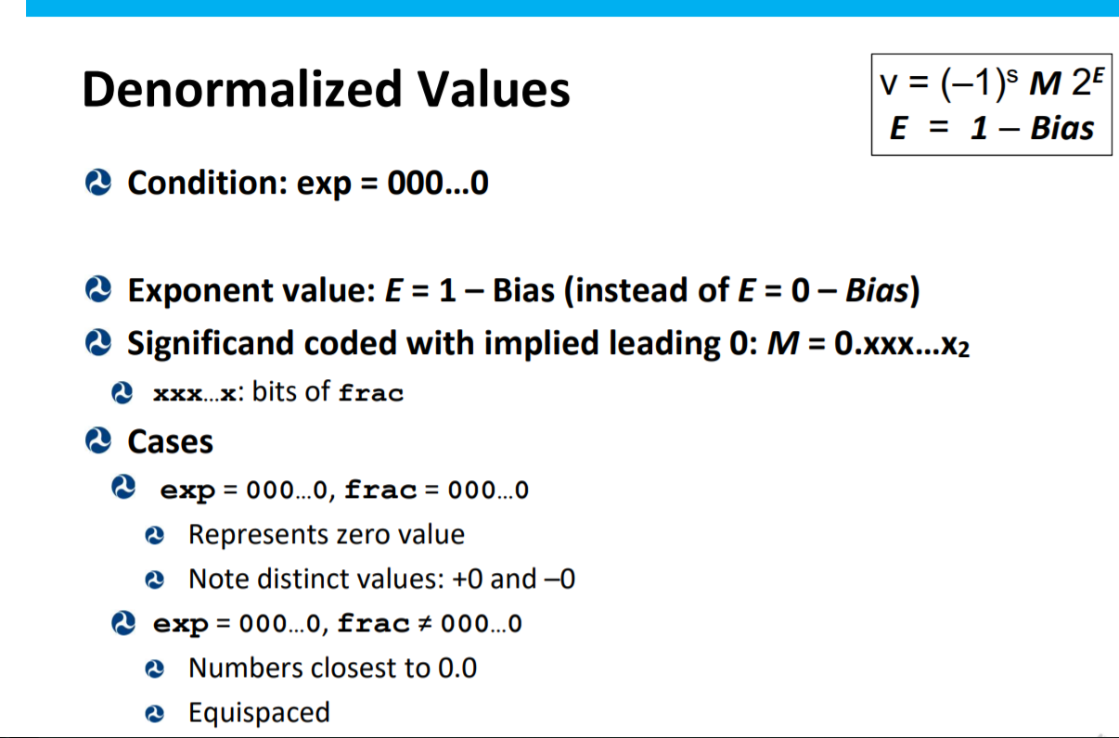
x86-64 Basics – Floating point

Slide 10
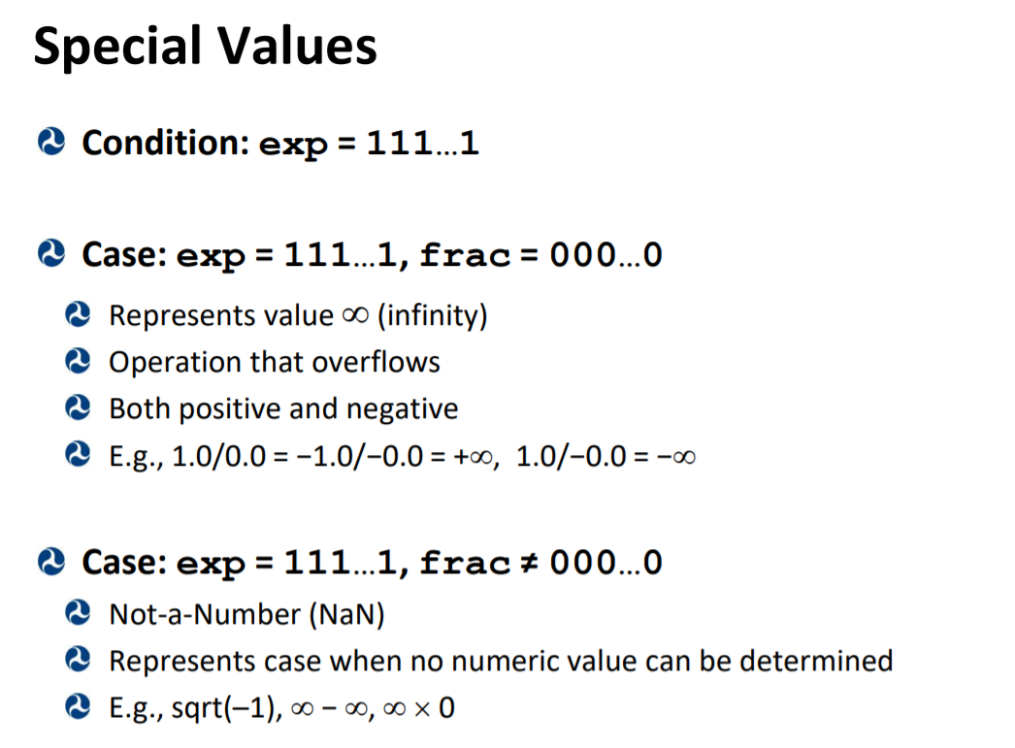
x86-64 Basics – Floating point

Slide 11
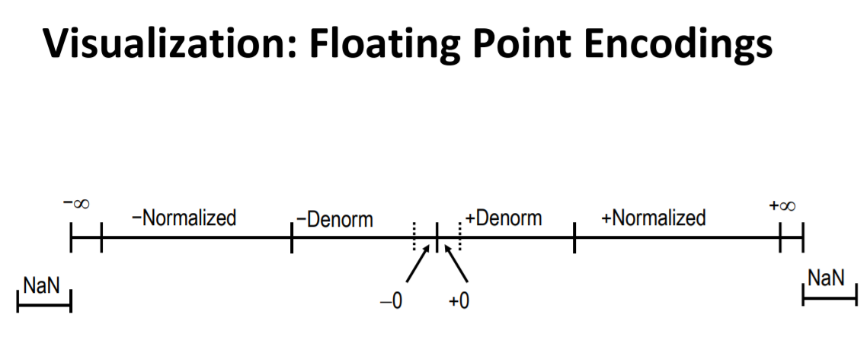
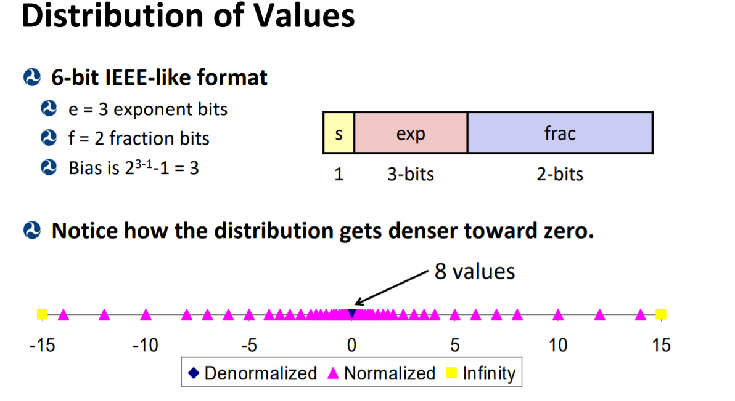
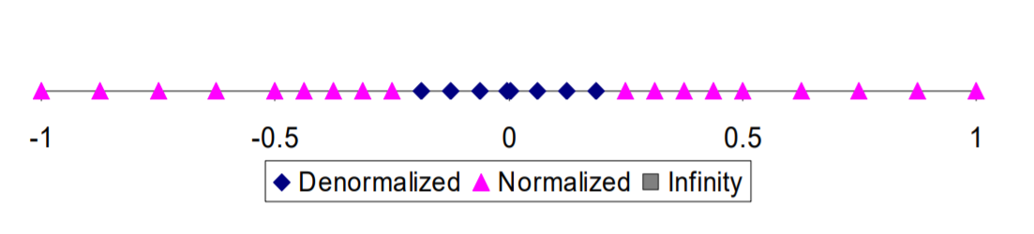
x86-64 Basics – Floating point

Slide 12
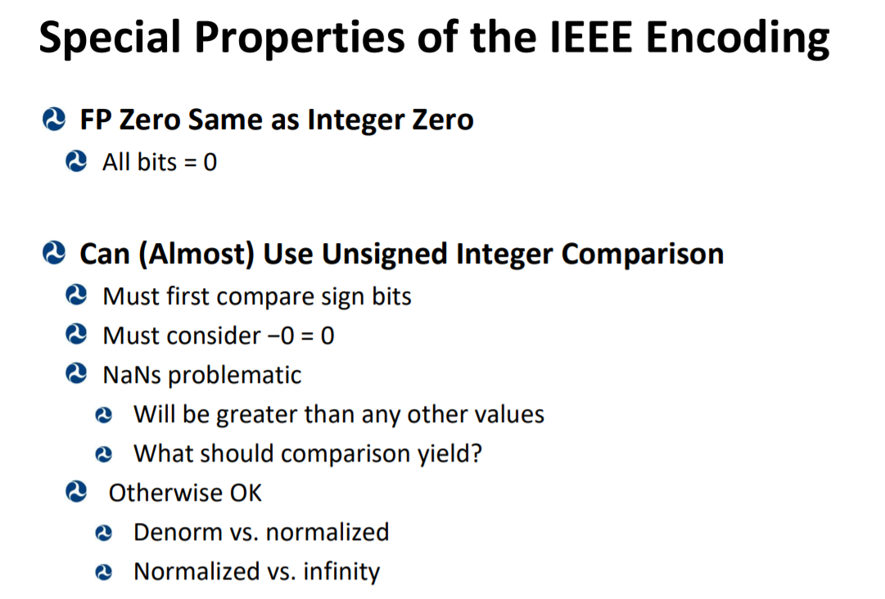
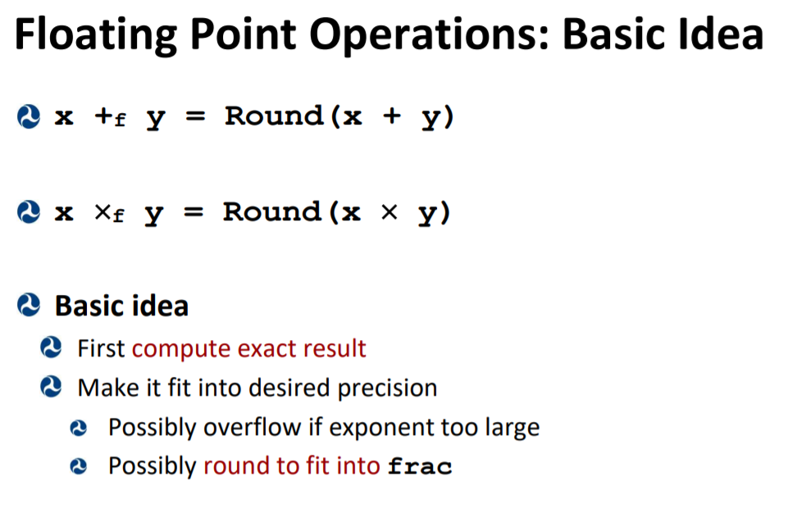
x86-64 Basics – Floating point

Slide 13
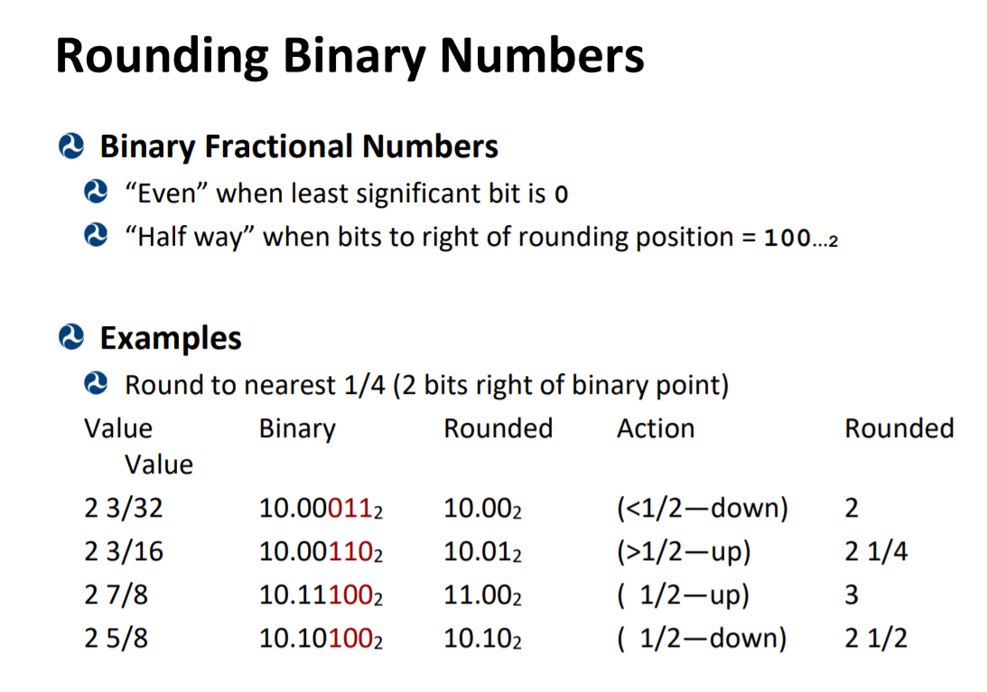
x86-64 Basics – Floating point

Slide 14
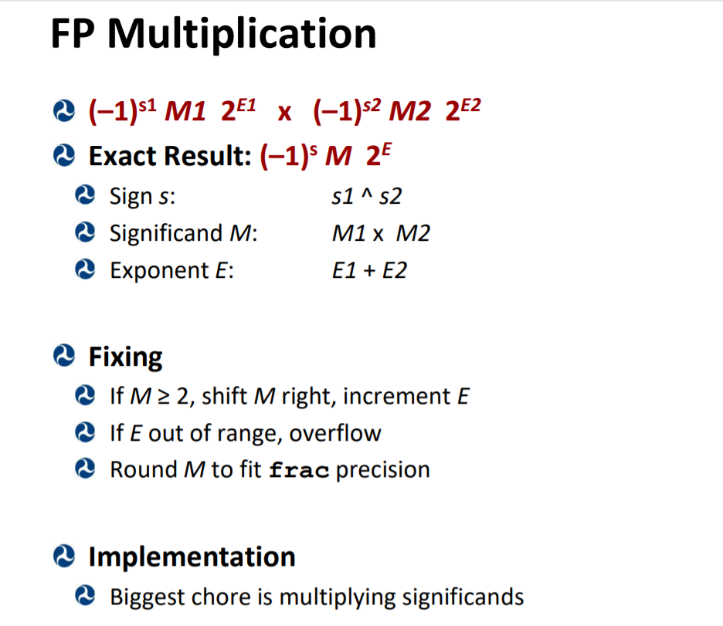
x86-64 Basics – Floating point

Slide 15
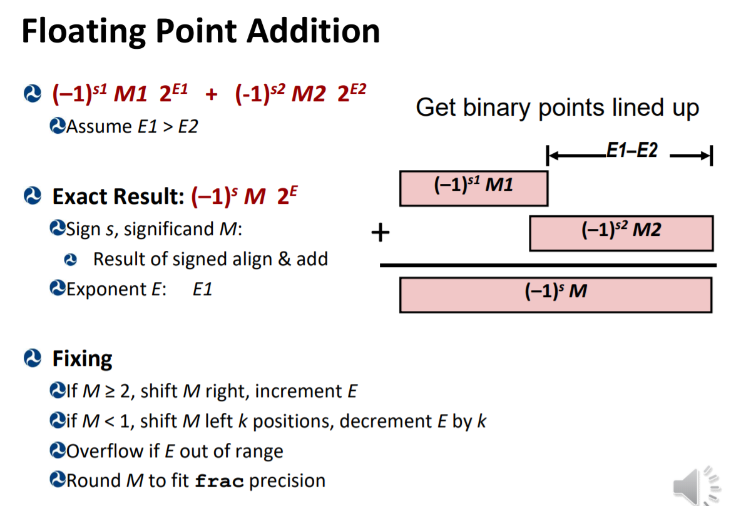
x86-64 Basics – Floating point

Slide 16
x86-64 Basics – Floating point

Slide 17
x86-64 Basics – Stack attacks
Stack overflow attacks
Inject code on stack to execute on stack
Through buffer overflow into local variables
e.g. int buffer[LIMIT] with |input| > LIMIT
Stick byte-code that corresponds to your ins
When it returns from function, pops ret val
Ret val overwritten to beginning of stack
Return oriented programming
Find desired byte code sequences for ins in text memory
Must end with c3 – for retq
Stick pointer to code on stack beginning at overwritten ret addr
(address)

Slide 18
x86-64 Basics – Stack attacks
Stack overflow attack protections
For first type:
make stack non-executeable
Permission bits on pages, can be hardware check
Randomize stack location
For ROP: use stack canaries
Special hidden value placed on stack after ret addr
See if ret addr overwritten with canary check
Then return from function else raise fault

Slide 19
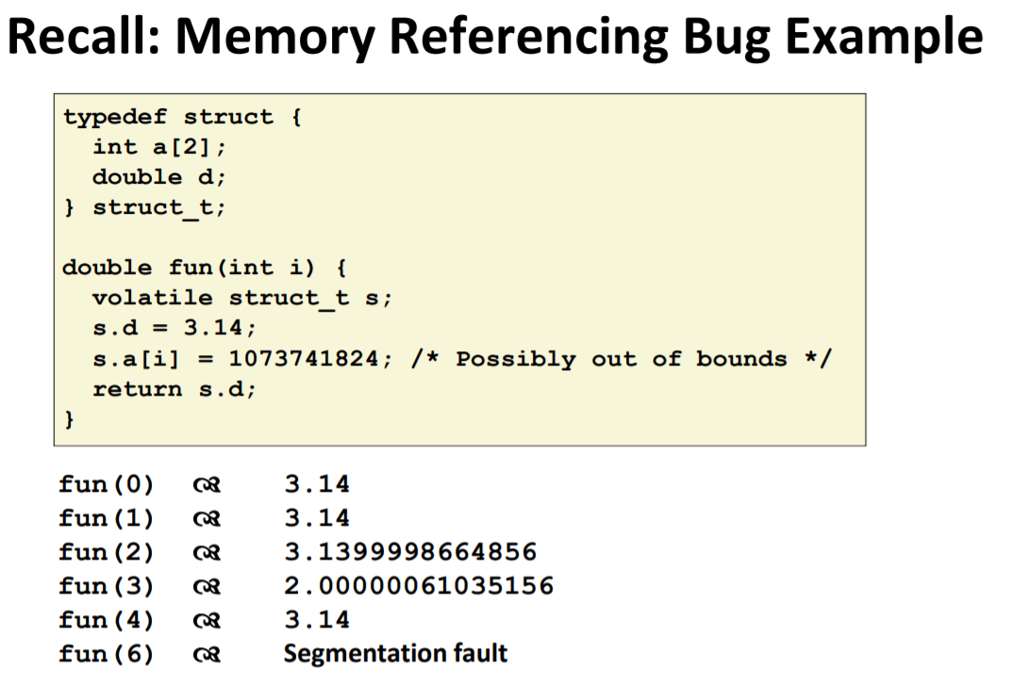
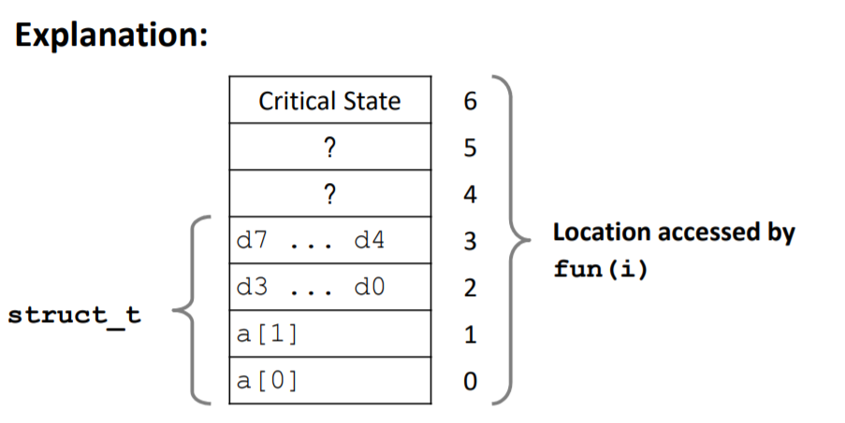
x86-64 Basics – Stack attacks

Slide 20
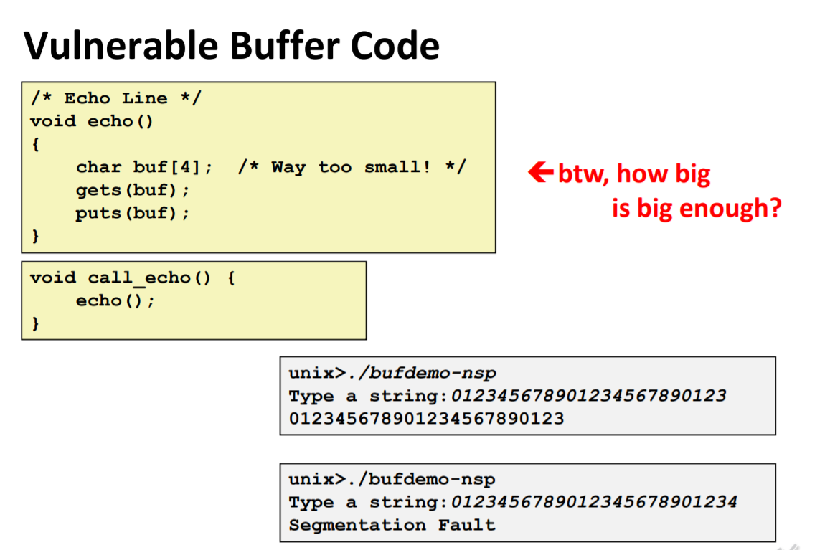
x86-64 Basics – Stack attacks

Slide 21
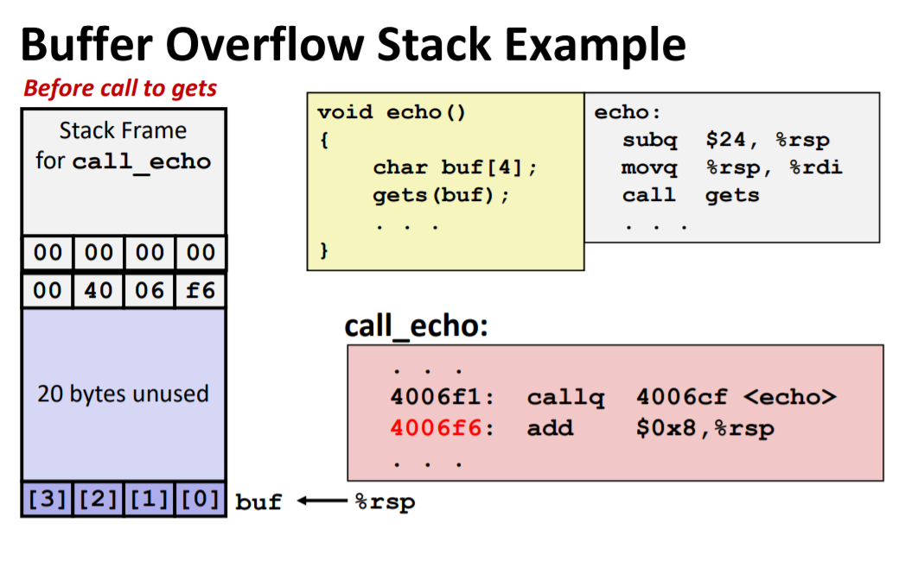
x86-64 Basics – Stack attacks

Slide 22
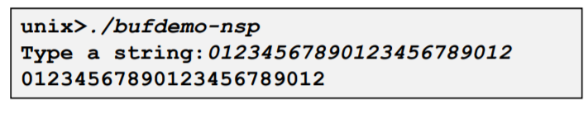
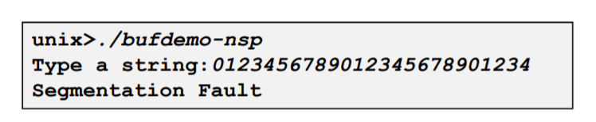
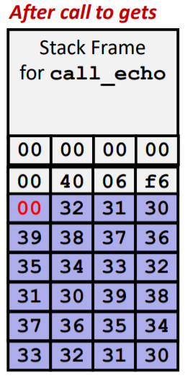
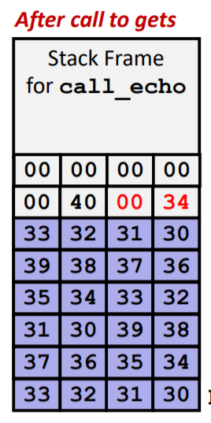
x86-64 Basics – Stack attacks
Could overwrite stack to jump to address that doesn’t cause seg fault

Slide 23
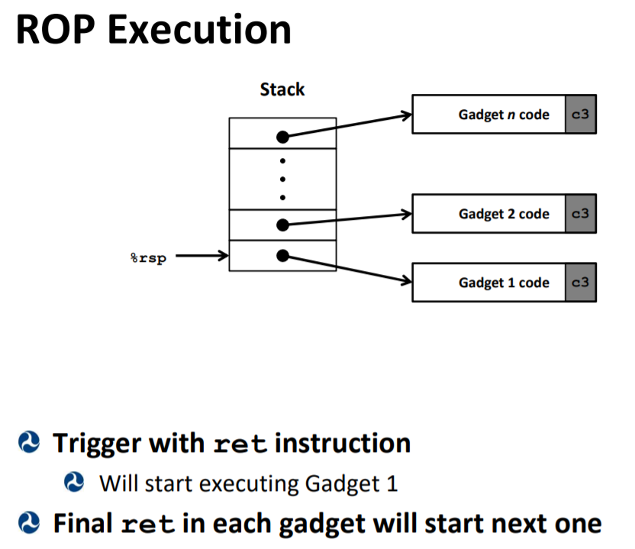
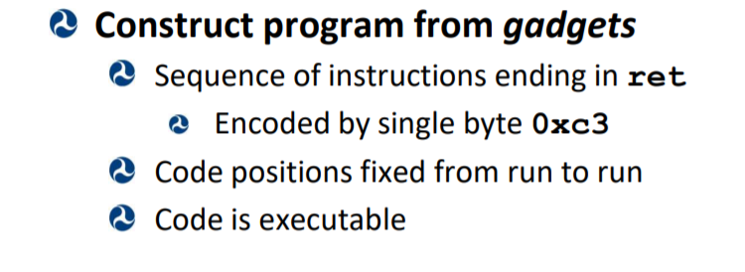
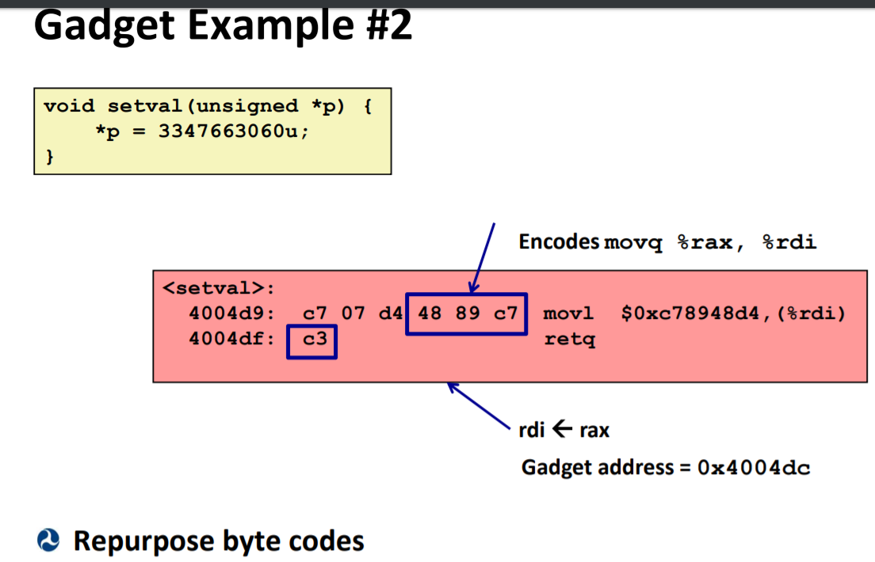
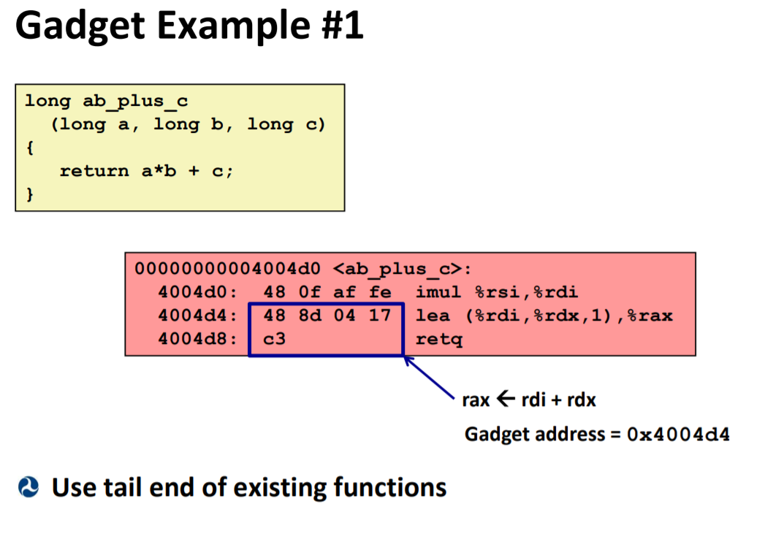
x86-64 Basics – Stack attacks ROP

Slide 24
x86-64 Basics – Optimization
Basic types of optimization:
Code motion
Reduction in Strength
Share common Subexpressions
Loop unrolling
Optimization blockers:
Procedure calls
Fix by doing own code motion
Inline functions
Memory Aliasing
Pointers can point to same object
Makes it so you have to access memory everytime to mutate object
Keep a local copy to amortize reads/writes
Accumulate in loop

Slide 25
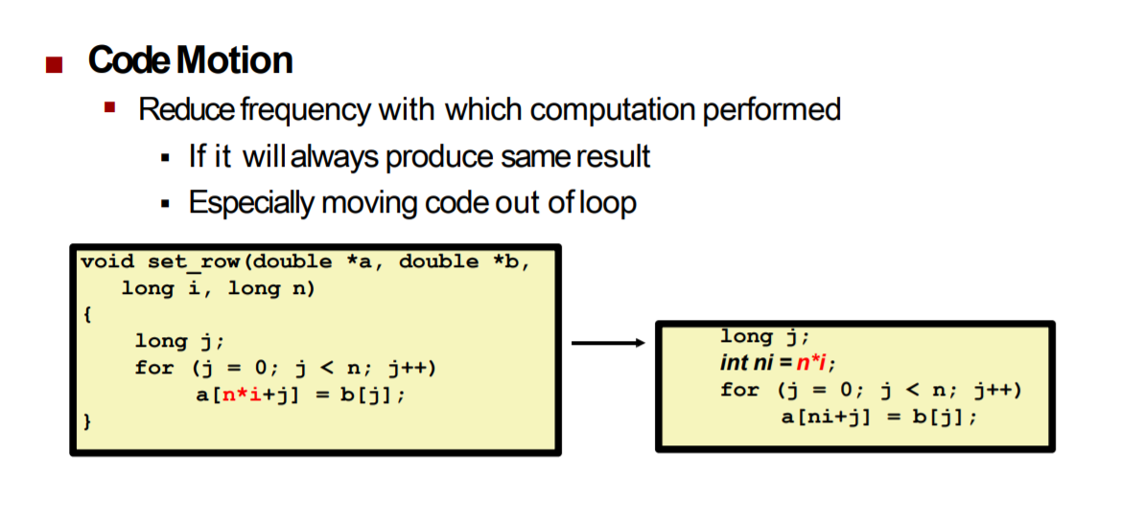
x86-64 Basics – Code motion

Slide 26
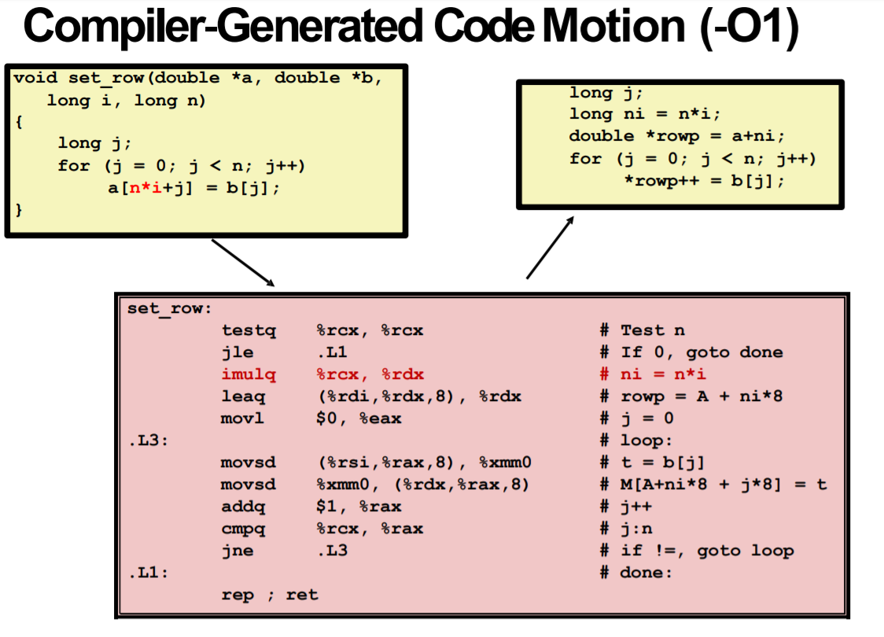
x86-64 Basics – Code motion

Slide 27
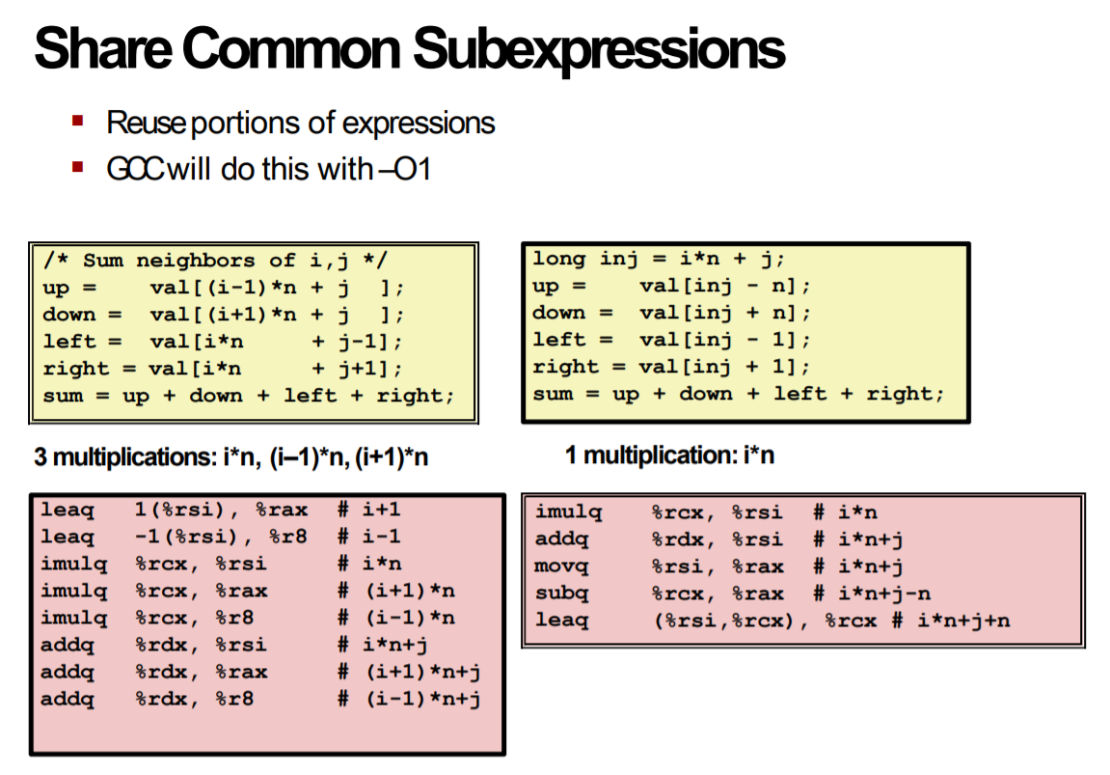
x86-64 Basics – share calculation

Slide 28
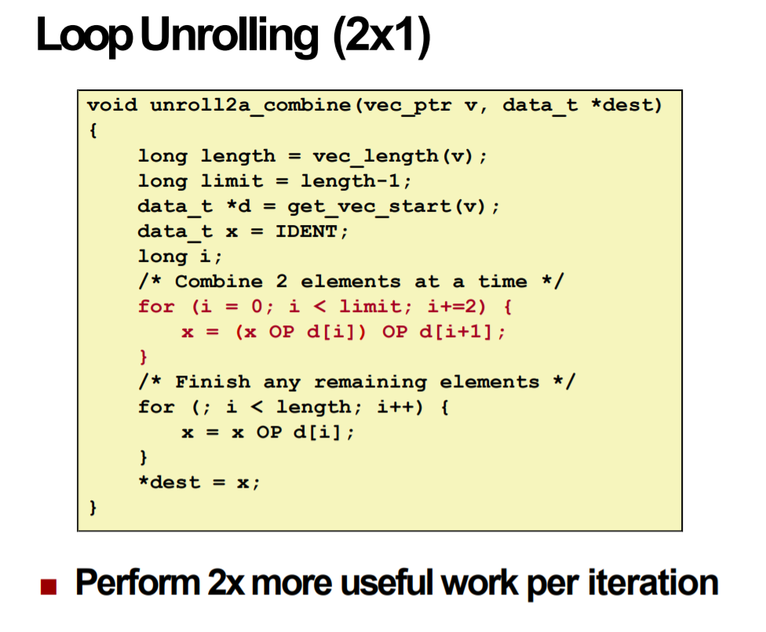
x86-64 Basics – Loop unrolling

Slide 29
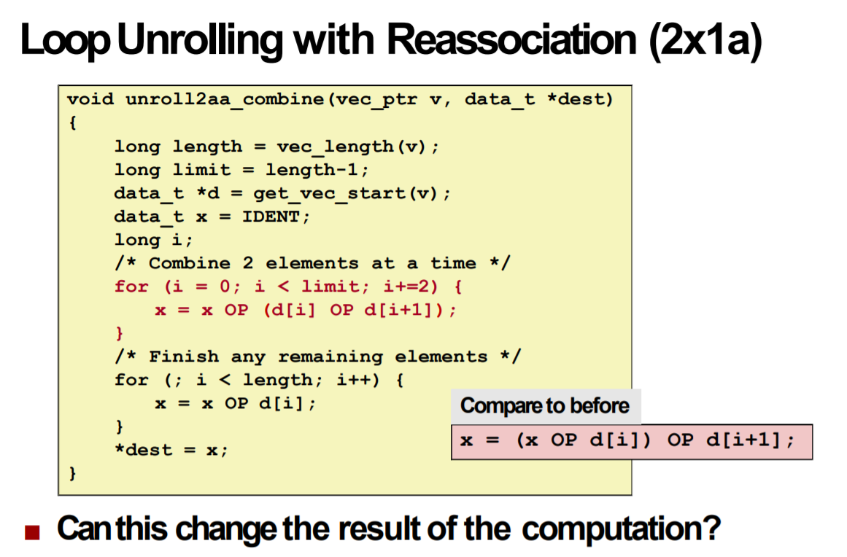
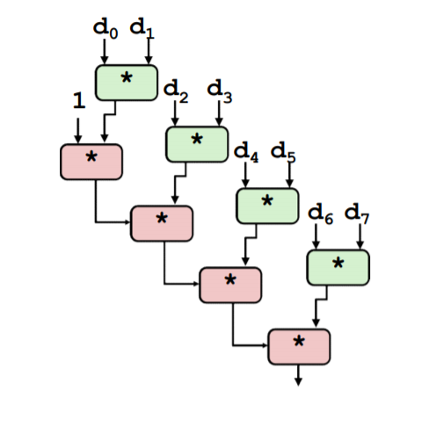
x86-64 Basics – Loop unrolling

Slide 30
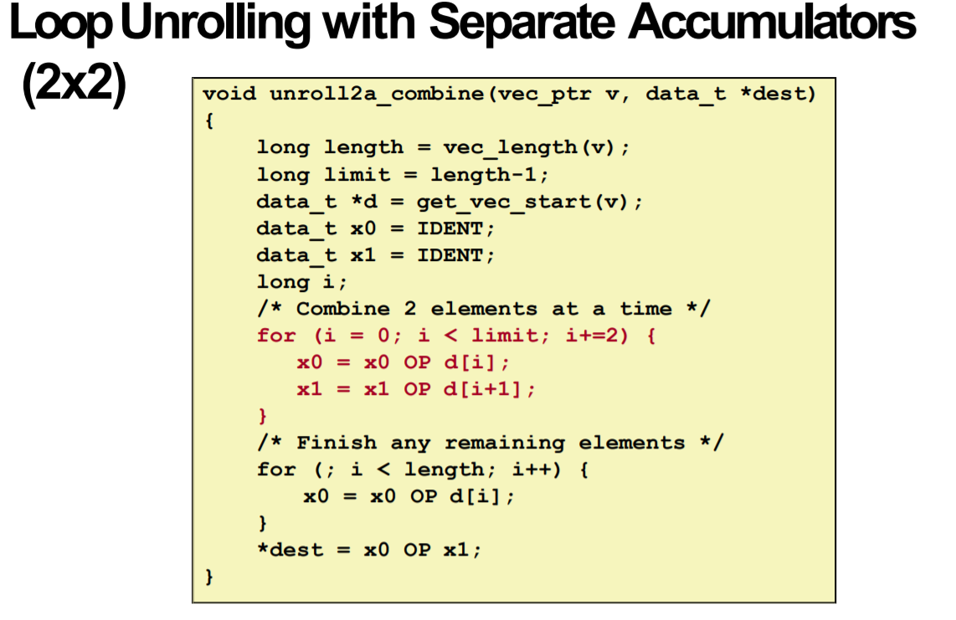
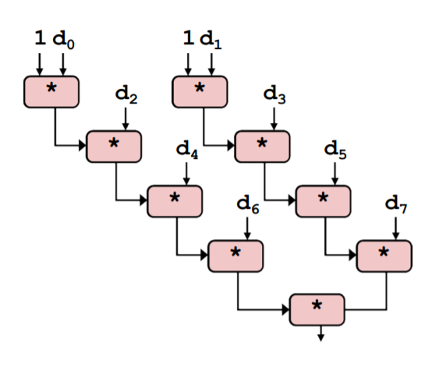
x86-64 Basics – Loop unrolling

Slide 31
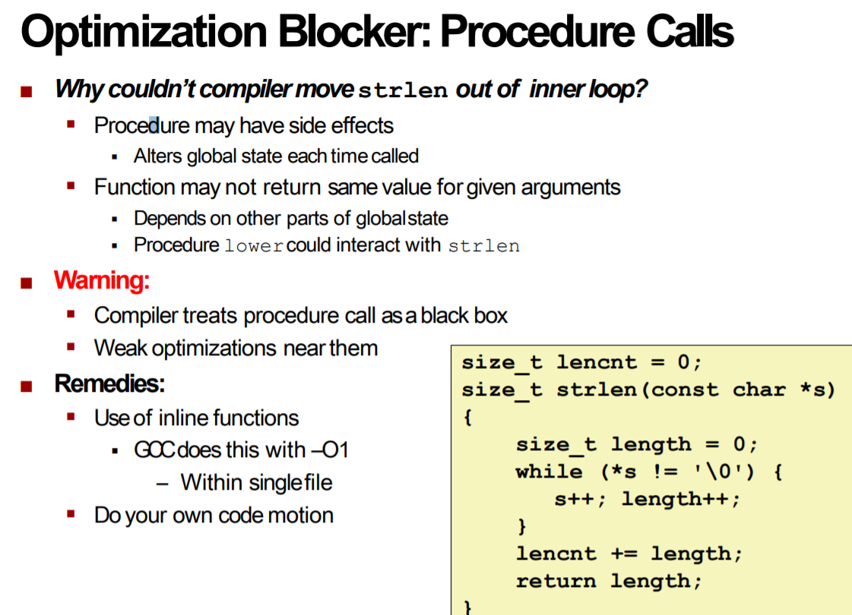
x86-64 Basics – Optimization block

Slide 32
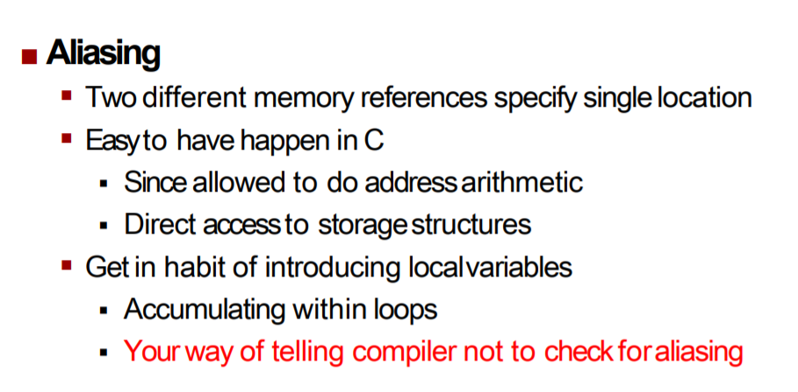
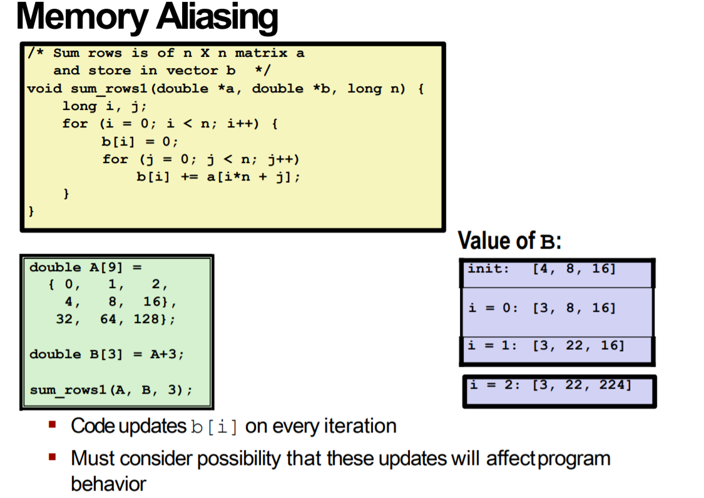
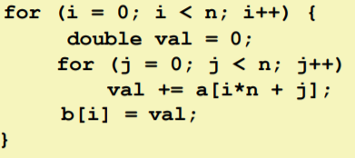
x86-64 Basics – Optimization block
FIX:

Slide 33
Questions before we start worksheet?

Slide 34
Resources used
Professor Reinman’s slides (CCLE)
Credit for compilation: Attiano Purpura-Pontoniere

